Slide 1
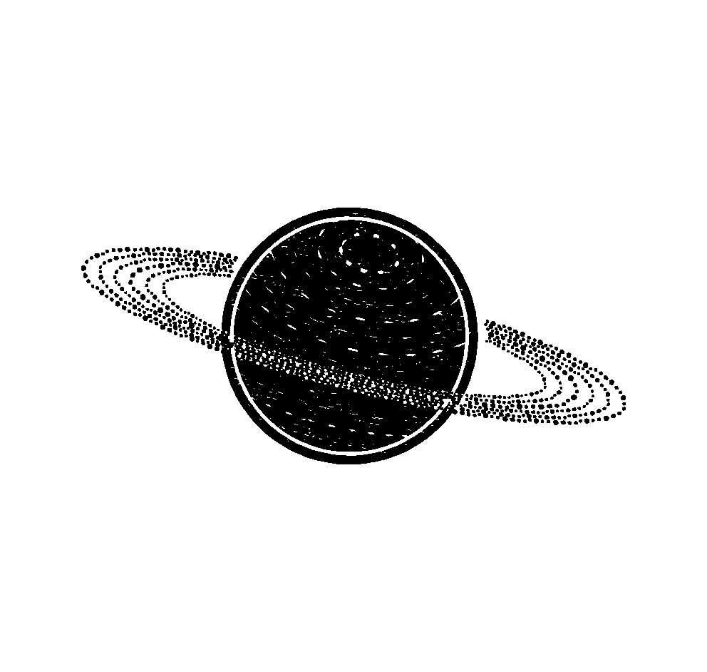
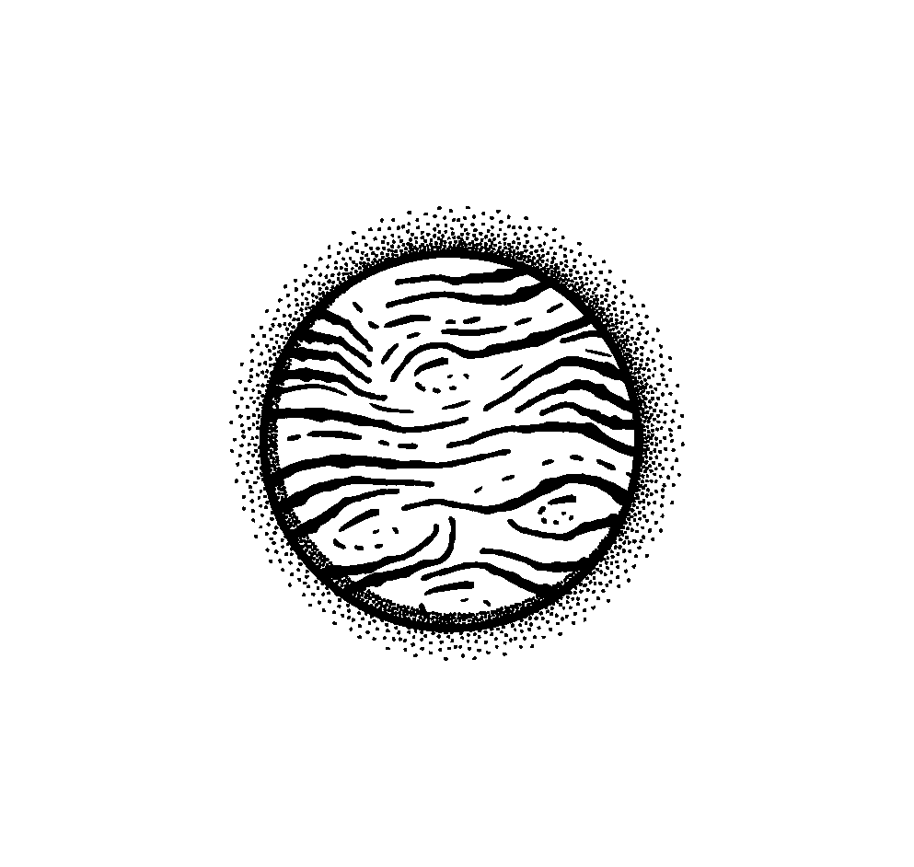
Innovative VR sandbox game: GraviCraft
Galactic Games: Fun in a Microgravity Environment
Kazakhstan, Petropavl 2024
By АнаНАСА

Slide 2
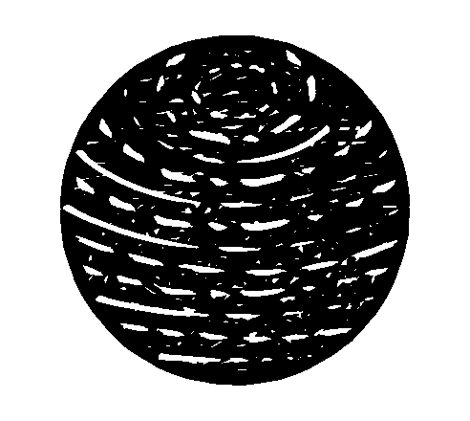
PROBLEMS OF BEING IN SPACE
01
02
03
04
Health Issues
Psychological Concern
During spaceflight, weight-bearing bones lose about 1% to 1.5% of mineral density per month, and astronauts lose muscle mass more rapidly than on Earth.
Astronauts may experience loneliness from prolonged isolation and stress from being far from home.
Reentry Disorientation
Area limitations
Reentry poses difficulties due to reduced gravitational cues, affecting balance and coordination.
Confined spaces in spacecraft can trigger claustrophobia and restrict physical activities, leading to increased stress and discomfort for astronauts.

Slide 3
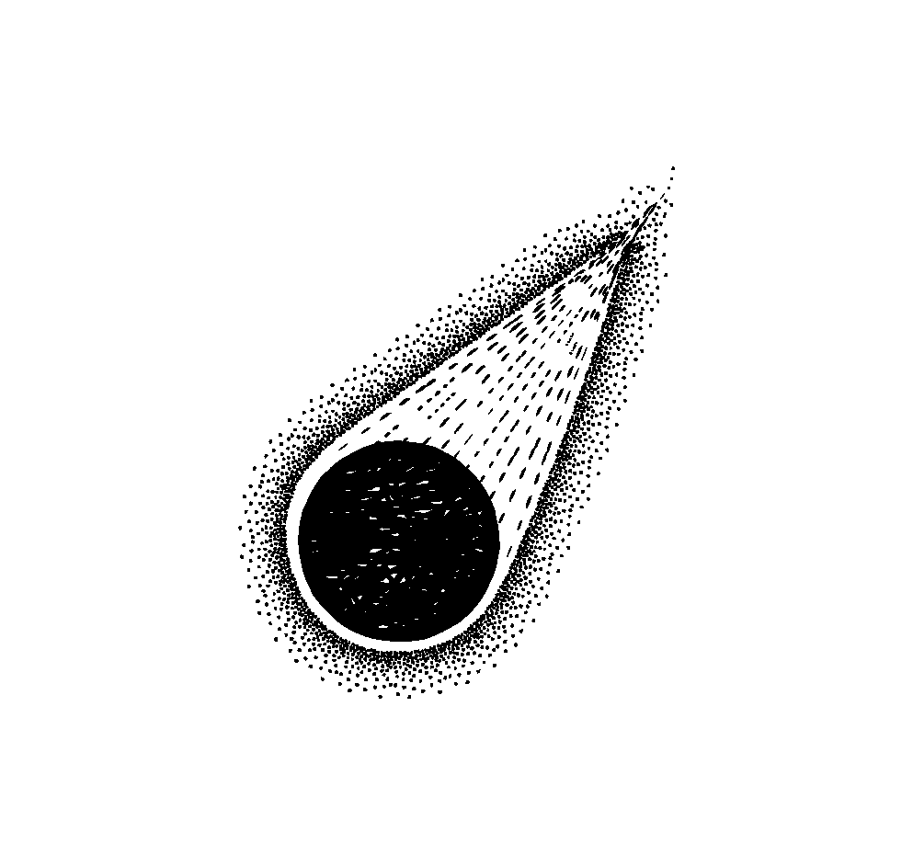
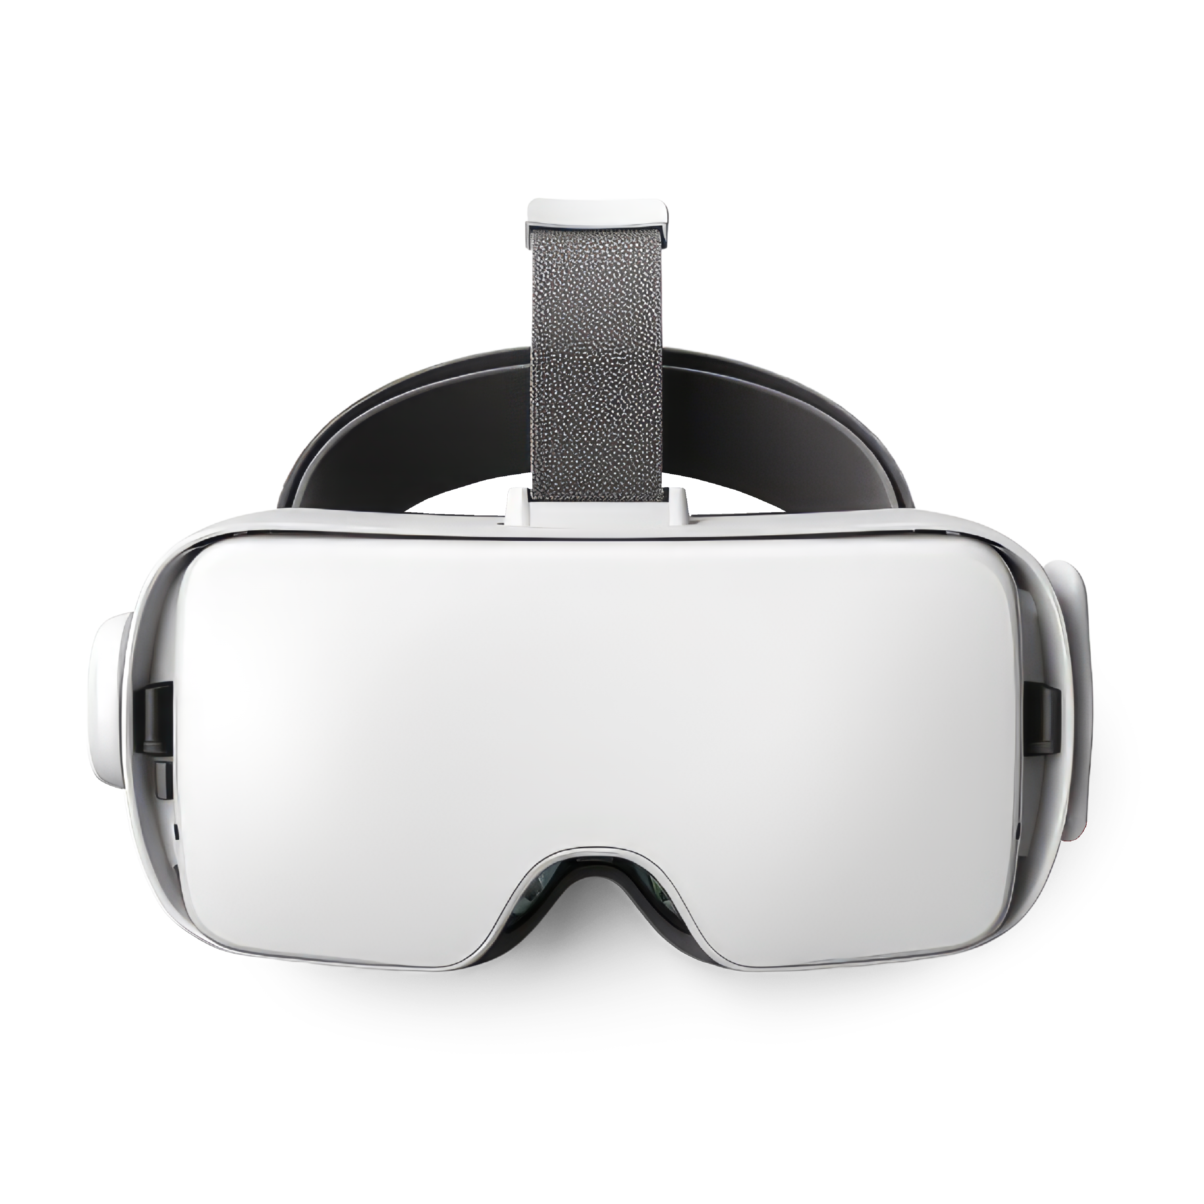
Our Solution
Introducing a solution designed to enhance astronaut well-being in microgravity: a compact exercise platform integrated with a VR sandbox game. Our platform simulates Earth's gravity, allowing astronauts to perform physical exercises using spring-loaded equipment. These movements are mirrored in the VR game, creating an immersive and engaging experience.

Slide 4
ADVANTAGES OF GRAVICRAFT
Entertainment and Stress Relief
Physical Fitness in Microgravity
Illusion of Open Space
The VR game entertains astronauts, reducing stress and offering a mental escape from the routine of space life.
The platform supports physical exercise, maintaining astronauts' muscle mass and fitness through engaging, realistic movements in microgravity.
The VR world creates a sense of vast space, alleviating astronauts' claustrophobia from the confined environment of space stations.
Teamwork and Cooperation
Earth Simulation and Gravity Training
Space Efficiency and Longevity
The platform simulates Earth’s gravity, helping astronauts adapt to future re-entry by avoiding the negative effects of microgravity.
The compact design fits limited spaces, while the sandbox nature of the game ensures endless and engaging gameplay.
Multiplayer gameplay encourages cooperation and camaraderie, fostering social connections and teamwork among the crew members.

Slide 5
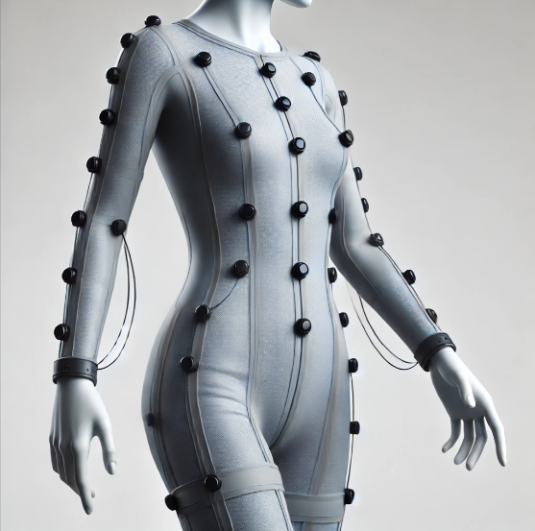
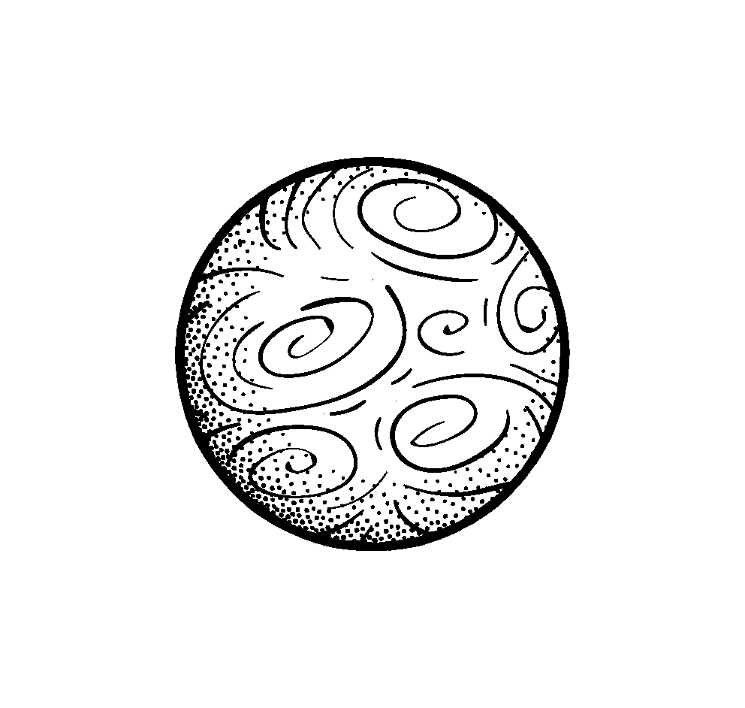
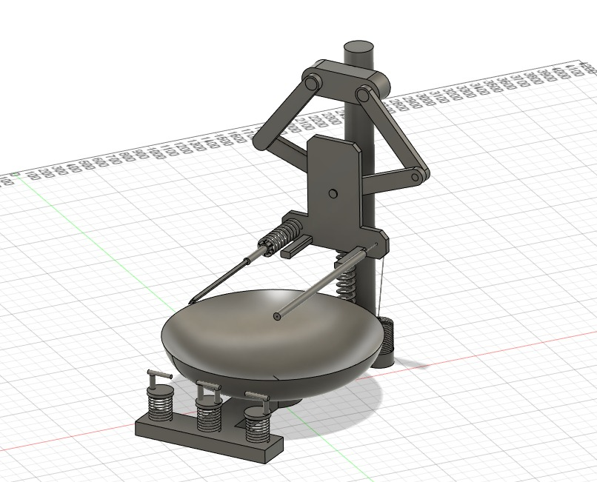
Game Suit
The AquaGuard Suit prevents sweat distribution in microgravity. Its moisture-wicking fabric channels sweat, while a sealed outer layer contains fluids. Integrated sensors and trackers monitor movement and collect data, ensuring hygiene and comfort during long missions.
3D MODEL
Demonstrates a 3D training model allowing users to perform exercises with adjustable tension. It features seating for stability, providing a safe environment for astronauts to enhance physical fitness in microgravity.

Slide 6
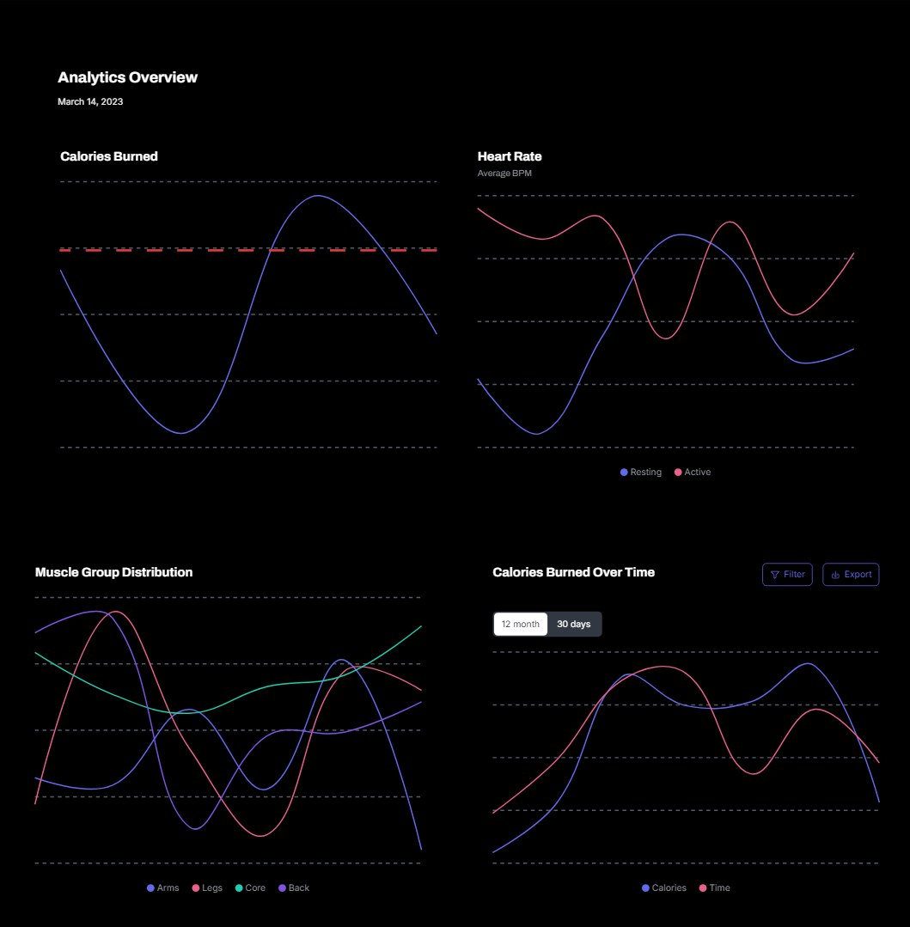
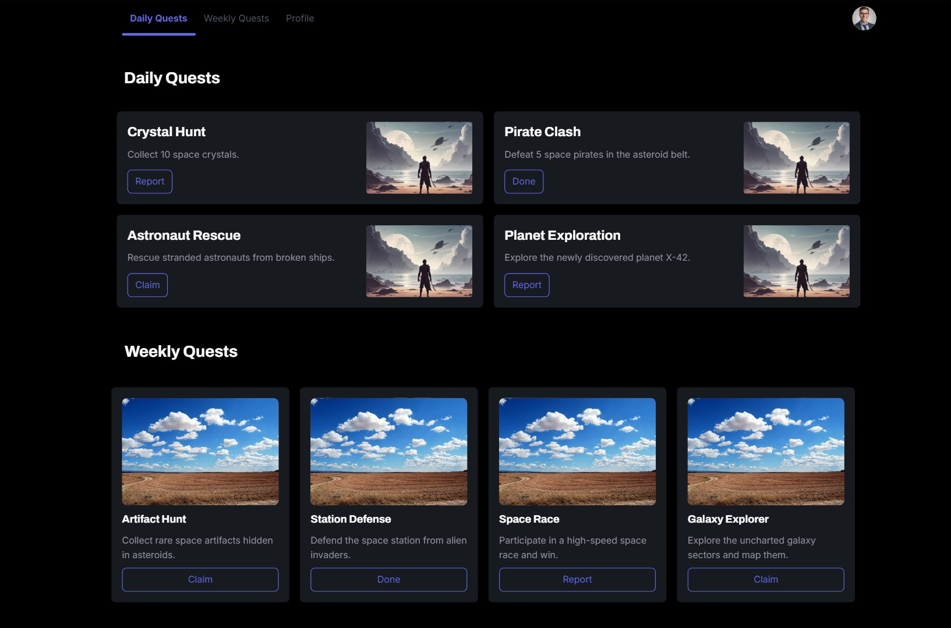
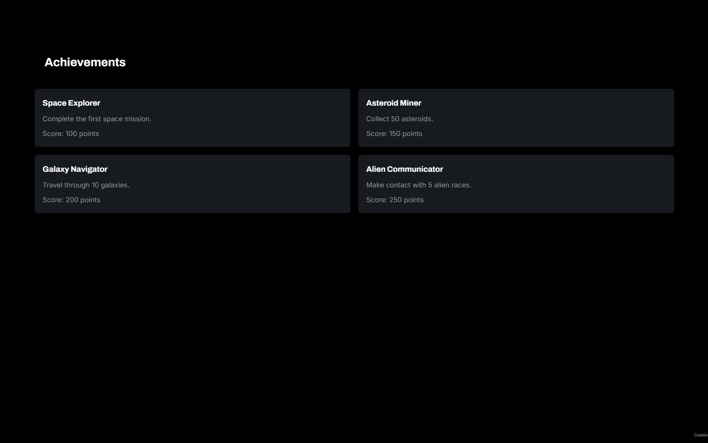
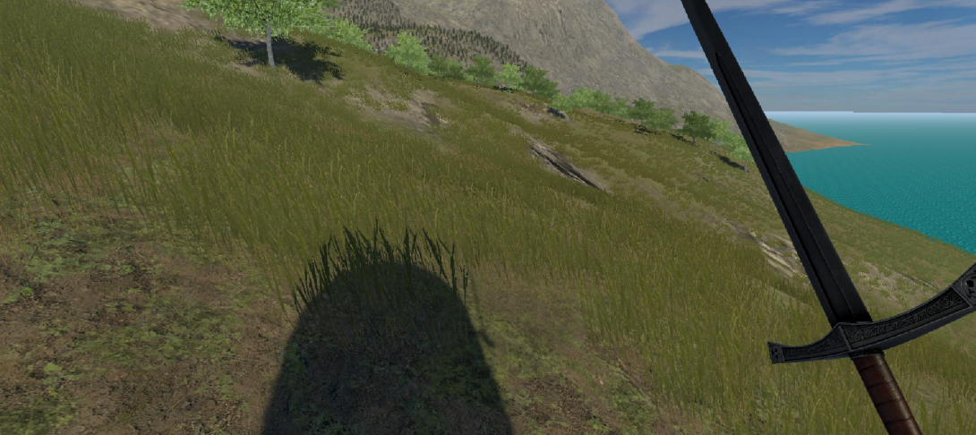
IN-GAME INTERFACE
GAME MENU
ACHIEVMENTS
STATISTICS
TERRAIN
The VR-friendly menu features intuitive icons for easy access to modes, multiplayer, settings, and statistics.
Achievements reward astronauts for exercises and milestones, promoting fitness and teamwork.
The game tracks performance metrics, providing insights into fitness and gameplay progress.
Procedurally generated terrain offers endless exploration, varied biomes, and combats claustrophobia.

Slide 7
—Mathew Ball
“
GravityCraft has enormous potential to improve the psychological and physical well-being of astronauts during long flights. It can help improve quality of life during and after flights, meanwhile .
”

